Slide 1
Music Ontology for Music Analysis
Ghițeanu Andrei-Daniel, ISI

Slide 2
Music ontology for music analysis:
Introduction
Content
Purpose
Concepts
Classes, Properties, Relations
Queries
Conclusion
Statistics
Examples
Summary Future steps

Slide 3
Introduction
Purpose:
Representing data related to musical elements (notes, pitches, intervals, chords) in order to help in score analysis.
Concepts:
Melody: represented by a stream of notes
Rhythm: formed from a stream of notes with different duration
Harmony: represended from chords
Sound: tone resulting from pitches

Slide 4
Classes and properties
Integrated classes:
Song
Part
MusicInterval
Note
Pitch
Genre
Style (subclass of Genre)
Relations:
hasPart: links songs to parts
hasInterval: links parts to intervals
hasNote: links parts to notes
hasPitch: links notes to pitches
pitchOfPart: links pitches to parts

Slide 5
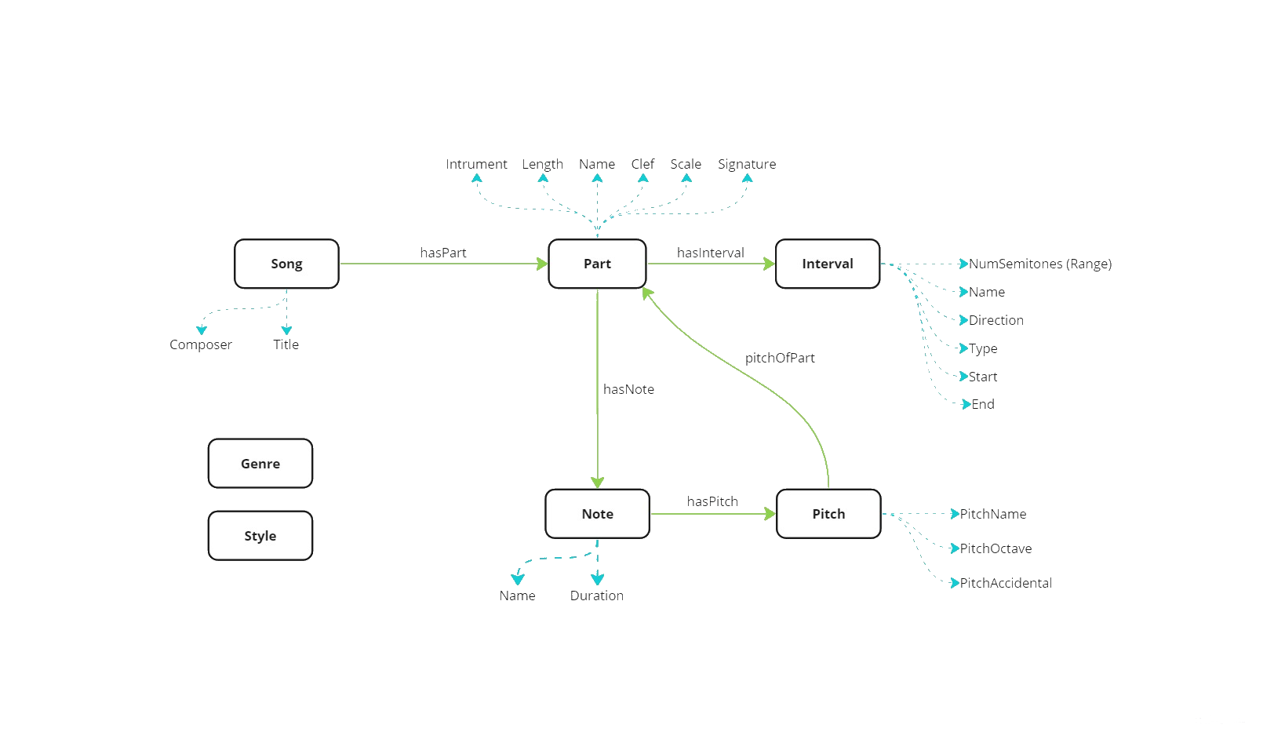
Ontology Schema:

Slide 6
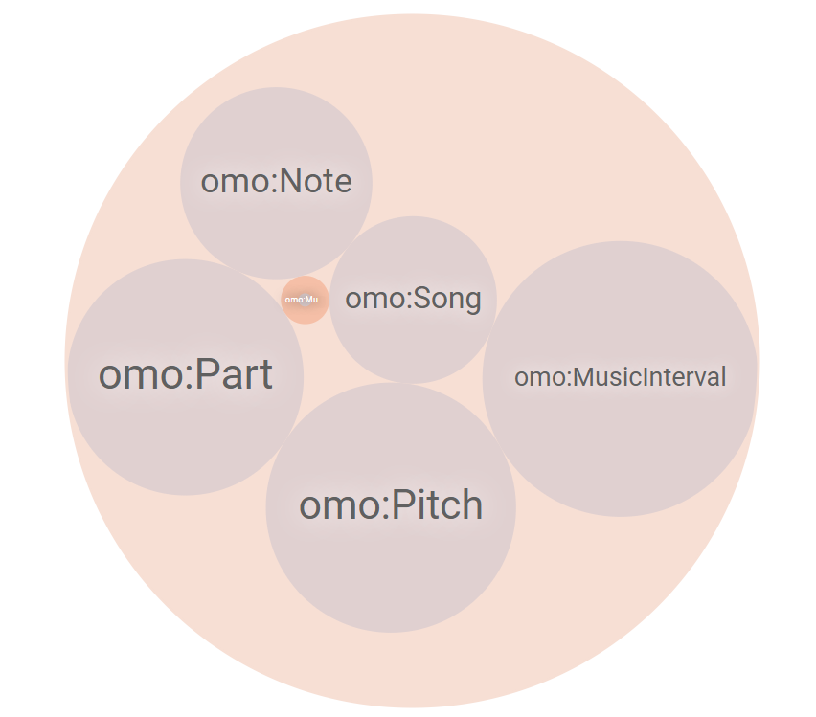
Details:
Number of instances:
Song: 52
Part: 272
Note: 94
Pitch: 378
MusicInterval: 697
MusicGenre: 1

Slide 7
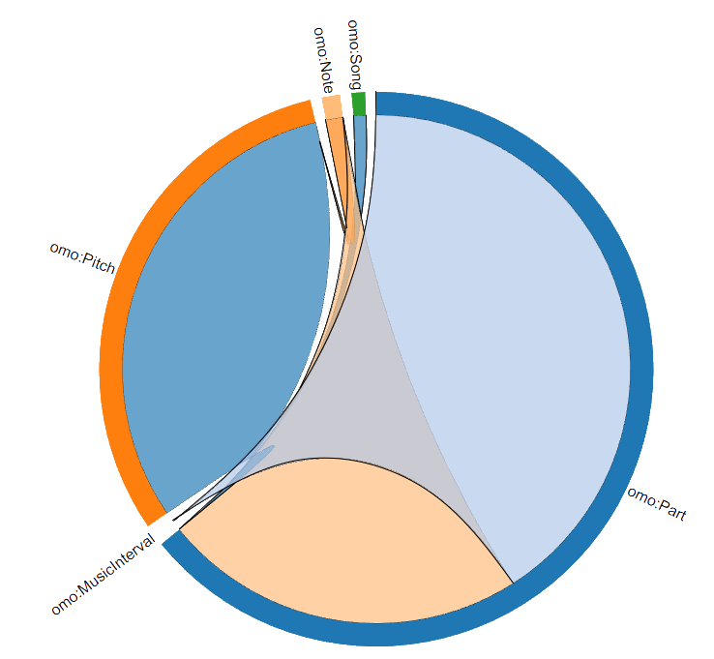
Relationships
Class | Links
Part | 32k
MusicInterval | 14k
Pitch | 11k
Note | 8k
Song | 272
Number of triplets: 41097
Number of defined properties: 33

Slide 8
Examples
PREFIX omo: http://onemusiconto.com/omo#
SELECT ?song
WHERE {
?song a omo:Song .
?song omo:hasPart ?part .
?part omo:hasInterval ?interval .
?interval omo:IntervalName "Descending Minor Third". (for more details) ?interval omo:IntervalStart "A-4".
}
PREFIX omo: <http://onemusiconto.com/omo#>
SELECT ?song
WHERE {
?song a omo:Song;
omo:SongComposer "Composer: Lodovico Agostini".
}

Slide 9
Conclusions
Summary:
Elements defined can be used to cover some compositional elements:
Melody
Rhythm
Sound
Different elements can be identified and used for score analysis
Future steps:
Approaching the concept of harmony:
Integrating measures and chords
Adding properties and links to chords

Slide 10
Thank you for your attention

